Slide 1
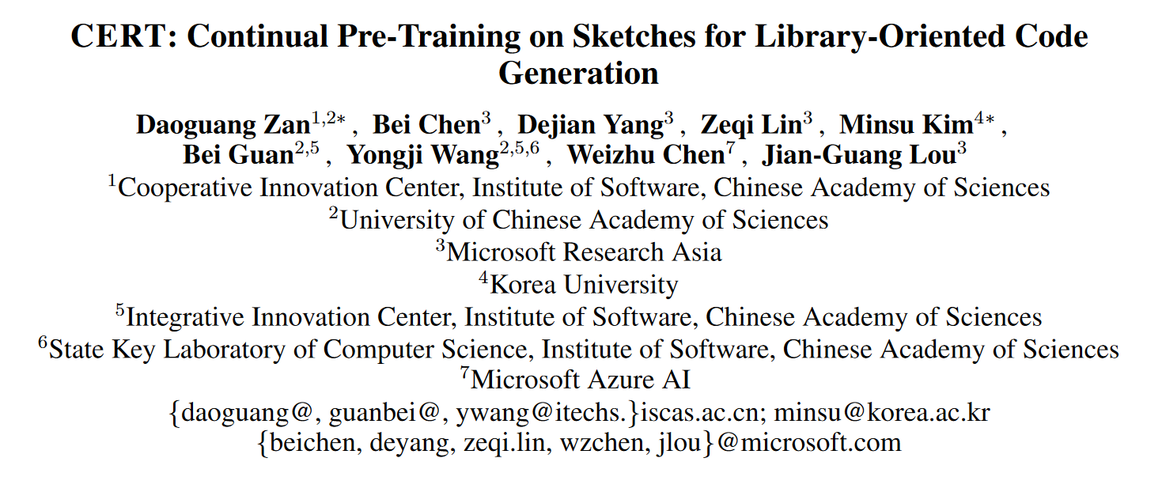
IJCAI 2022

Slide 2
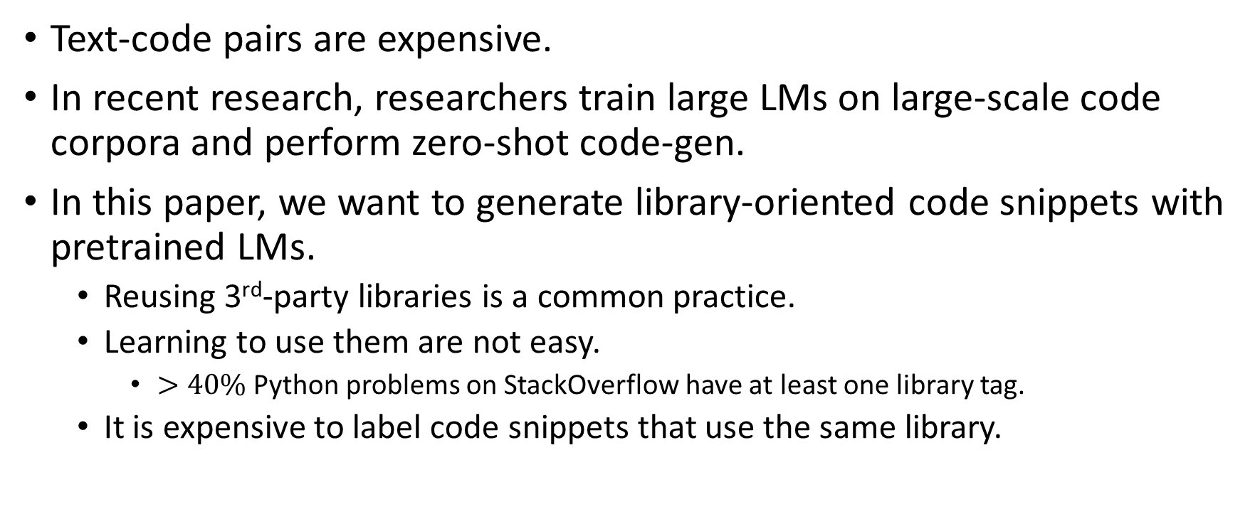
Introduction
Text-code pairs are expensive.
In recent research, researchers train large LMs on large-scale code corpora and perform zero-shot code-gen.
In this paper, we want to generate library-oriented code snippets with pretrained LMs.
Reusing 3rd-party libraries is a common practice.
Learning to use them are not easy.
$>40\%$ Python problems on StackOverflow have at least one library tag.
It is expensive to label code snippets that use the same library.

Slide 3
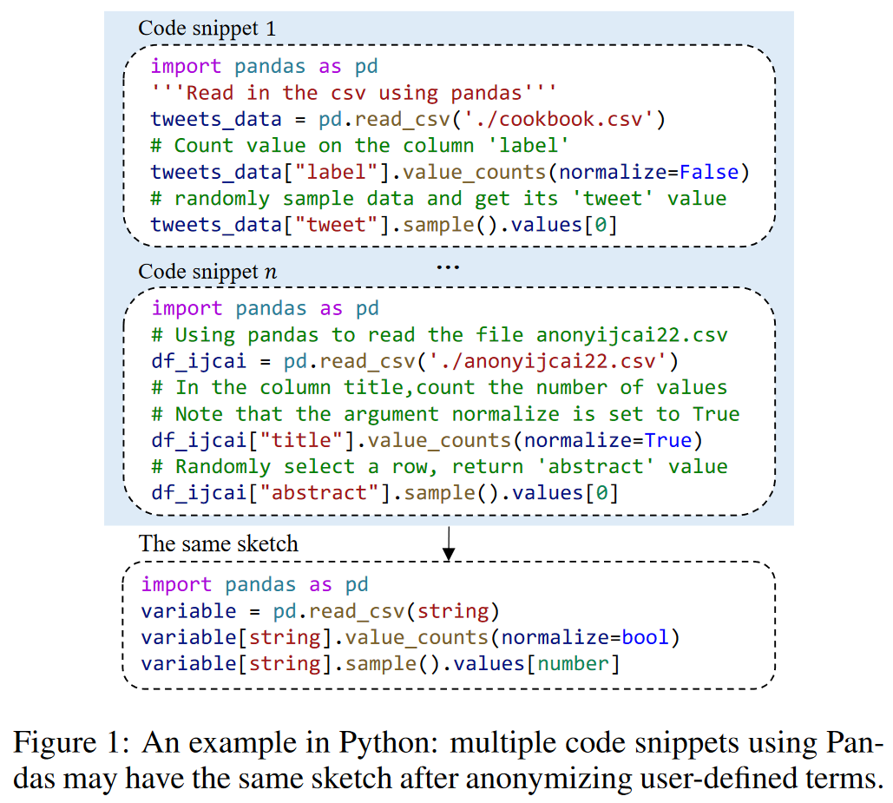
Introduction
Library-oriented code snippets are more likely to share similar sketches.
We define sketch as the code structure after anonymizing user-defined terms, e.g. variables, constants, etc.
This has also been identified as API usage patterns by previous researchers.

Slide 4
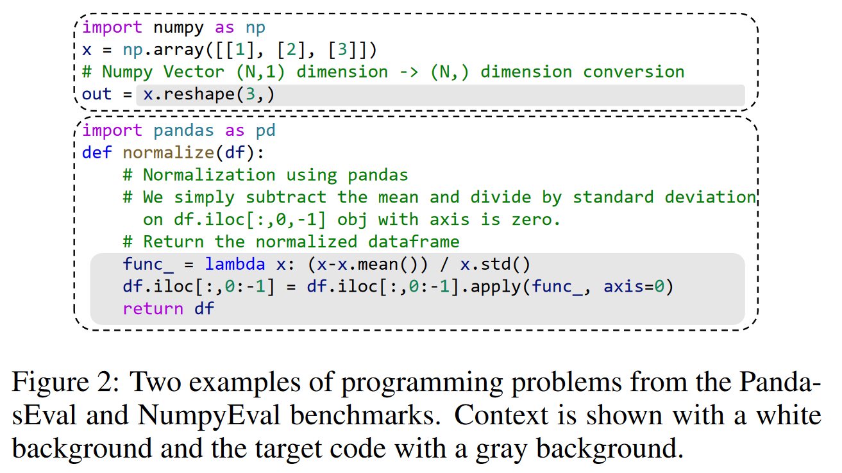
Task Formulation

Slide 5
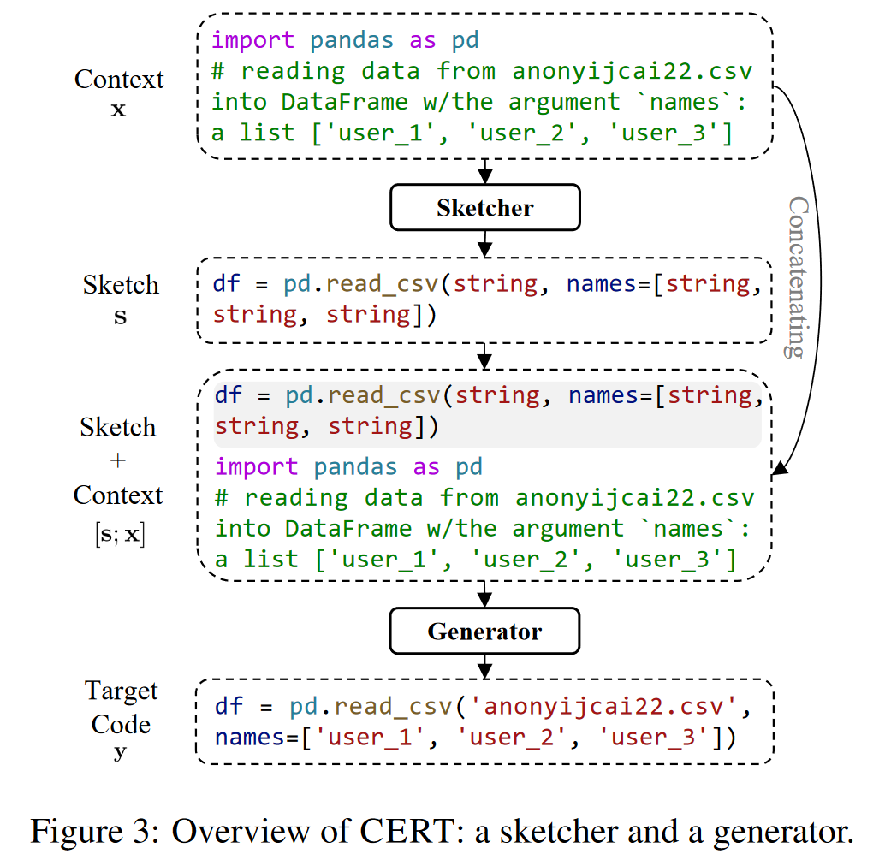
CERT
Given x as the input, the sketcher predicts the sketch, s.
Given concat(x, s) as input, the generator predicts the target code y.
The sketcher and the generator are built by continual pre-training on base model.

Slide 6
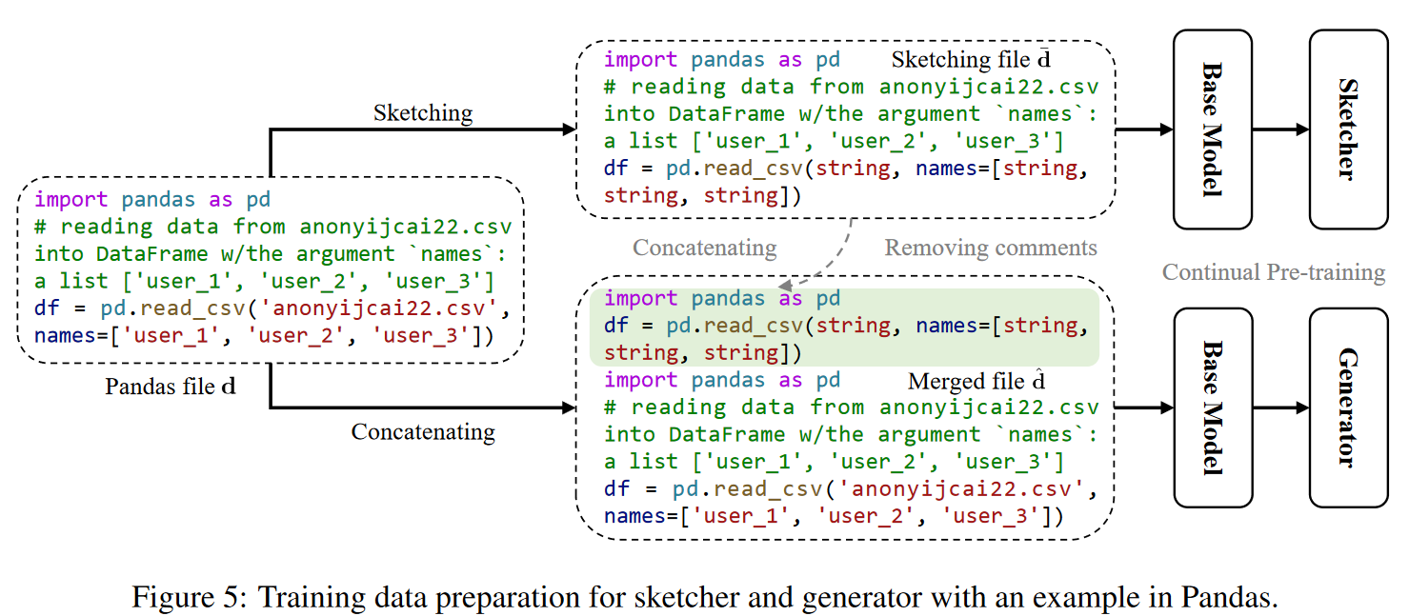
CERT
Extract files that use a specific library as a sub-corpus.
Use the sub-corpus to continue pre-training.

Slide 7
Benchmarks
Little work has been done to evaluate library-oriented code-gen.
We craft PandasEval and NumpyEval, for Pandas and Numpy, respectively.
Each sample is a programming problem consisting of context and target code.
We search for posts using the library tag on StackOverflow, and select accepted answers with high votes.
We manually organize them into the form needed for our benchmarks, and polish them so that the descriptions are clear and the codes are correct.

Slide 8
Benchmarks
We craft 101 programming problems for each dataset.
We equip Each problem is equipped with test cases for evaluation.
We create 20 test cases for problems in the form of a function.
64% in PandasEval, 30% in NumpyEval.
We create 1 test case for other problems.
We pre-train the model on a self-collected GitHub corpus, so the data are not leaked.

Slide 9
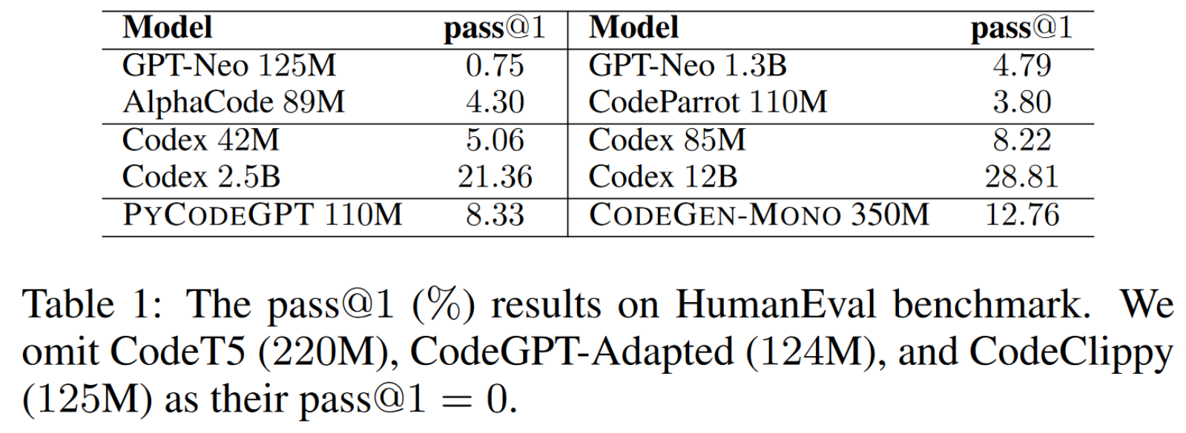
Base Models
Previous researchers' attempts to reproduce Codex failed.
We pre-trained a LM, PyCodeGPT, on a carefully cleaned Python dataset collected from GitHub (13.0M files after cleaning).
We also use CodeGen as one of our base models.

Slide 10
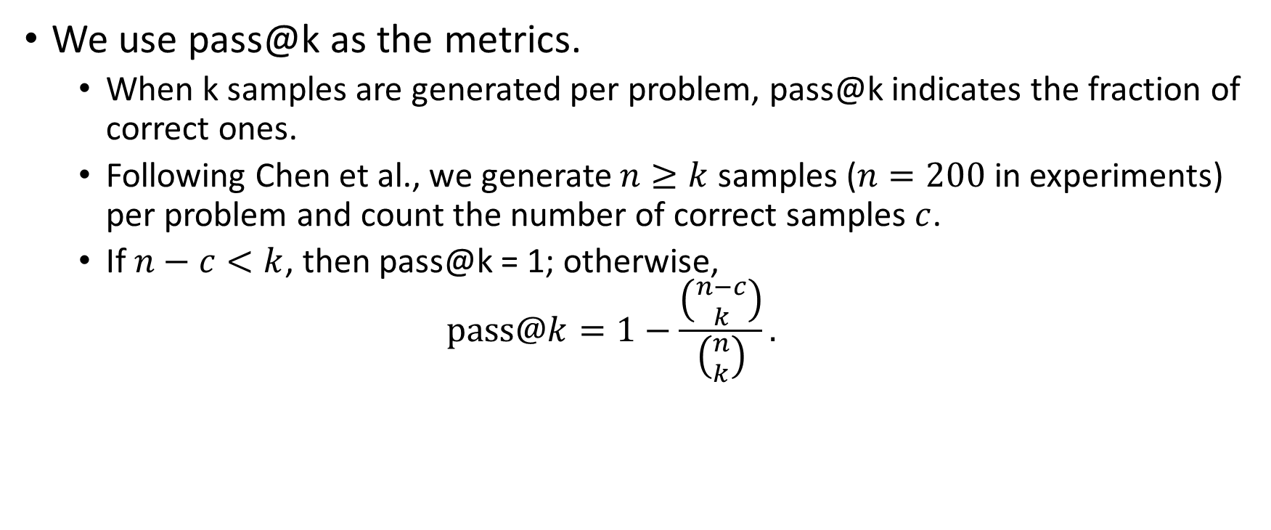
Evaluation Metrics
We use pass@k as the metrics.
When k samples are generated per problem, pass@k indicates the fraction of correct ones.
Following Chen et al., we generate $n≥k$ samples ($n=200$ in experiments) per problem and count the number of correct samples $c$.
If $n−c<k$, then pass@k = 1; otherwise,
$$pass@k=1−\frac{\left({n−c \atop k}\right)}{\left({n \atop k}\right)}.$$

Slide 11
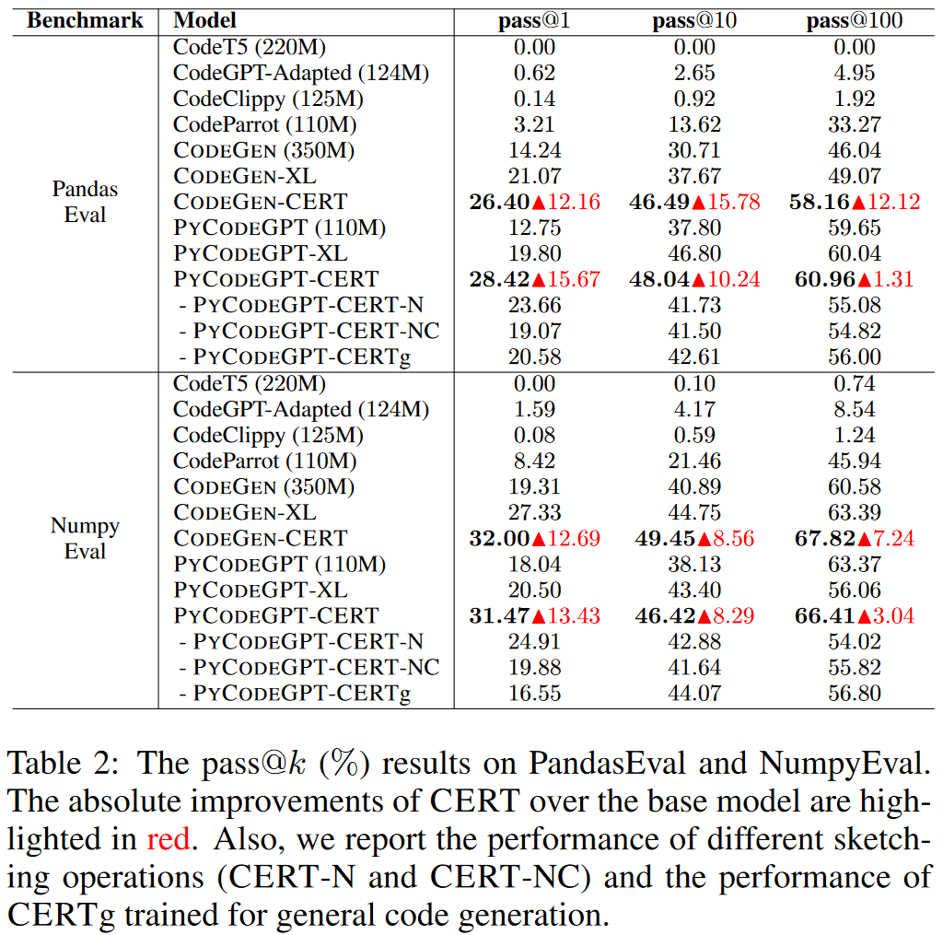
Results
PyCodeGPT-XL and CodeGen-XL are continual pre-trained PyCodeGPT and CodeGen on the extracted sub-corpus.
CERT only anonymizes user-defined constants.
CERT-N anonymizes only user-defined names.
CERT-NC anonymizes both.

Slide 12
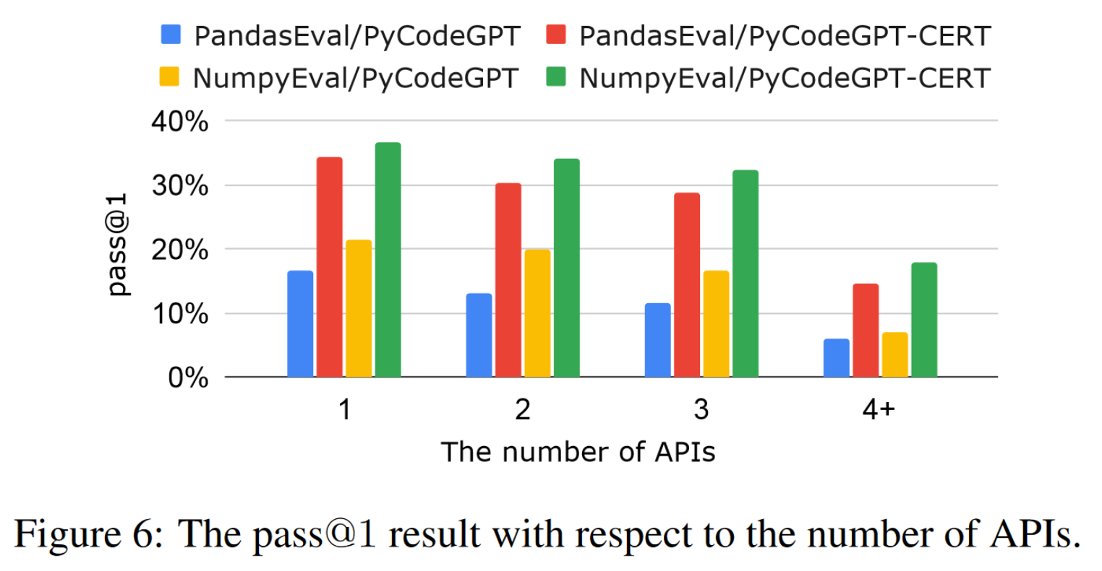
Results

Slide 13
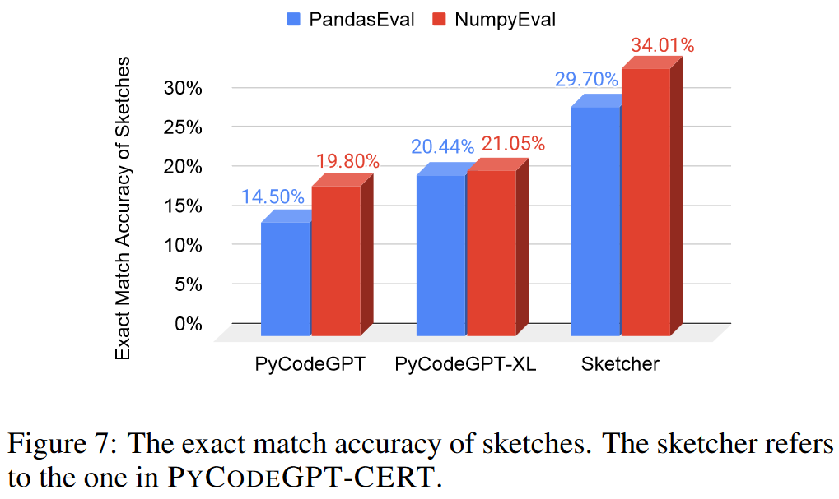
Results
The sketcher generates multiple (200 in experiments) candidates, and we choose the one that appears the most (in all experiments).

Slide 14
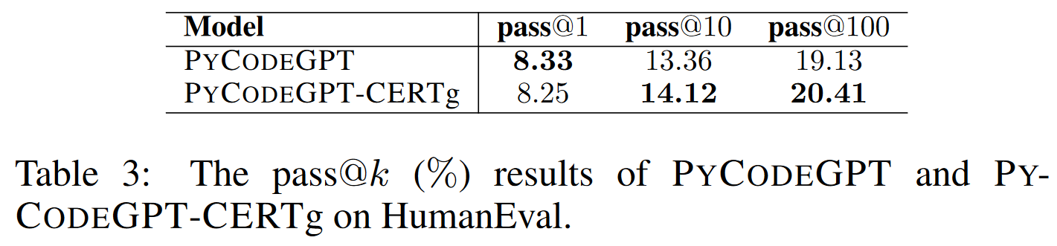
Results
We continually pre-train PyCodeGPT using the whole corpus using CERT, and obtain a model CERTg.

Slide 15
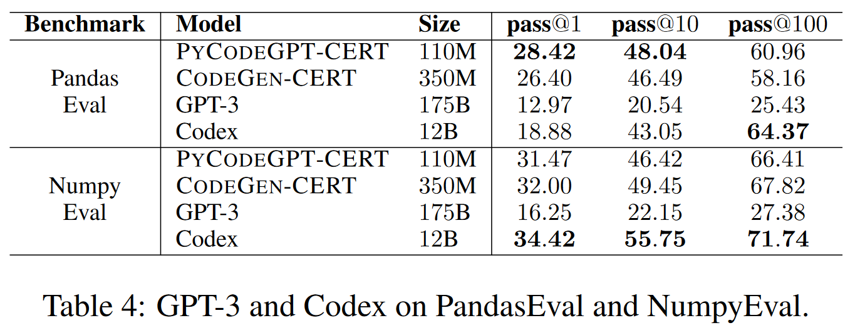
Results

Slide 16
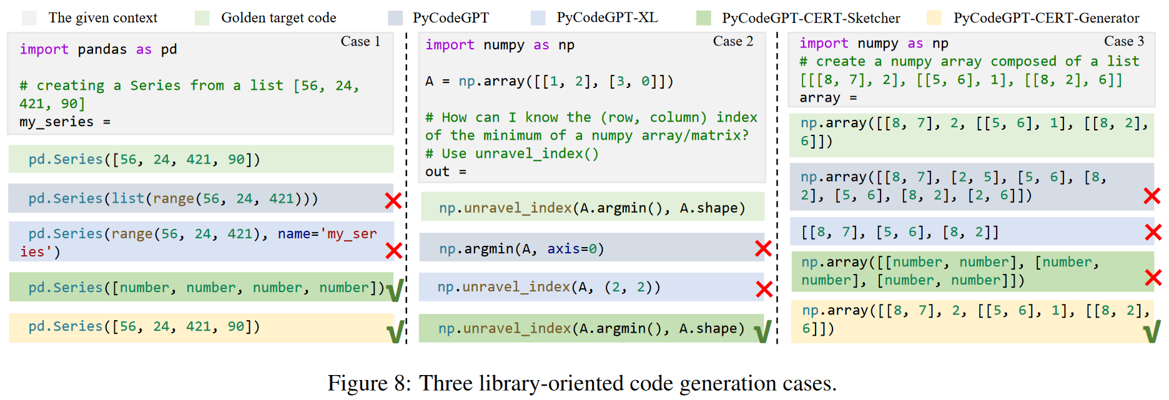
Case Study

